Slide 1

INSTITUTE - UIE
DEPARTMENT- ACADEMIC UNIT-2
Bachelor of Engineering (Computer Science & Engineering)
Subject Name: Object Oriented Programming using C++
Subject Code:20CST151
Unit-2
Topic : Polymorphism
DISCOVER . LEARN . EMPOWER

Slide 2


Object Oriented Programming using C++
Course Objectives
To enable the students to understand various stages and constructs of C++ programming language and relate them to engineering programming problems.
To improve their ability to analyze and address variety of problems in programming domains.

Slide 3



Course Outcomes
CO Number | Title | Level
CO1 | Provide the environment that allows students to understand object-oriented programming Concepts | Understand
CO2 | Demonstrate basic experimental skills for differentiating between object-oriented and procedural programming paradigms and the advantages of object-oriented programs. | Remember
CO3 | Demonstrate their coding skill on complex programming concepts and use it for generating solutions for engineering and mathematical problems. | Understand
CO4 | Develop skills to understand the application of classes, objects, constructors, destructors, inheritance, operator overloading and polymorphism, pointers, virtual functions, exception handling, file operations and handling. | Understand

Slide 4
Scheme of Evaluation
Sr. No. | Type of Assessment Task | Weightage of actual conduct | Frequency of Task | Final Weightage in Internal Assessment (Prorated Marks) | Remarks
1. | Assignment* | 10 marks of each assignment | One Per Unit | 10 marks | As applicable to course types depicted above.
2. | Time Bound Surprise Test | 12 marks for each test | One per Unit | 4 marks | As applicable to course types depicted above.
3. | Quiz | 4 marks of each quiz | 2 per Unit | 4marks | As applicable to course types depicted above.
4. | Mid-Semester Test** | 20 marks for one MST. | 2 per semester | 20 marks | As applicable to course types depicted above.
5. | Presentation*** |  |  | Non Graded: Engagement Task | Only for Self Study MNGCourses.
6. | Homework | NA | One per lecture topic (of 2 questions) | Non-Graded: Engagement Task | As applicable to course types depicted above.
7. | Discussion Forum | NA | One per Chapter | Non Graded: Engagement Task | As applicable to course types depicted above.
8. | Attendance and Engagement Score on BB | NA | NA | 2 marks

Slide 5
CONTENTS
Introduction & types of polymorphism,
Function overloading,
The word polymorphism means having many forms.
In simple words, we can define polymorphism as the ability of a message to be displayed in more than one form.

Slide 6
WHAT IS POLYMORPHISM
In programming languages, polymorphism means that some code or operations or objects behave differently in different contexts.
For example, the + (plus) operator in C++[2]:
4 + 5 <-- integer addition
3.14 + 2.0 <-- floating point addition
s1 + "bar" <-- string concatenation!
In C++, that type of polymorphism is called overloading.
Typically, when the term polymorphism is used with C++, however, it refers to using virtual methods, which we'll discuss shortly.

Slide 7
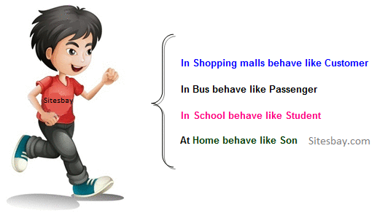
WHAT IS POLYMORPHISM
In programming languages, polymorphism means that some code or operations or objects behave differently in different contexts.
For example, the + (plus) operator in C++:
4 + 5 <-- integer addition
3.14 + 2.0 <-- floating point addition
s1 + "bar" <-- string concatenation!
In C++, that type of polymorphism is called overloading.
Typically, when the term polymorphism is used with C++, however, it refers to using virtual methods, which we'll discuss shortly.
Figure 5.1 Real life example of polymorphism[1]

Slide 8
EMPLOYEE EXAMPLE
Here, we will represent 2 types of employees as classes in C++[2]:
a generic employee (class Employee)
a manager (class Manager)
For these employees, we'll store data, like their:
name
pay rate
And...we'll require some functionality, like being able to:
initialize the employee
get the employee's fields
calculate the employee's pay
To help demonstrate polymorphism in C++, we'll focus on the methods that calculate an employee's pay.

Slide 9
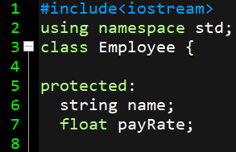
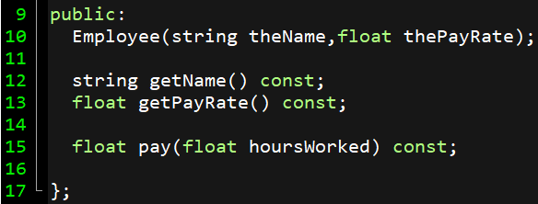
EMPLOYEE EXAMPLE
Figure 5.2 example of polymorphism[2]

Slide 10
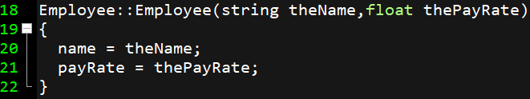
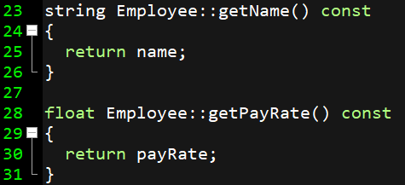
EMPLOYEE EXAMPLE
Figure 5.3 example of polymorphism[2]

Slide 11
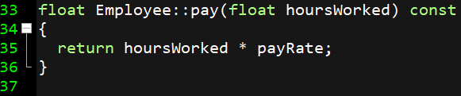
EMPLOYEE EXAMPLE
SAME FUNCTION WE’LL BE DEFINING
FOR CLASS MANAGER
Figure 5.4 example of polymorphism[2]

Slide 12
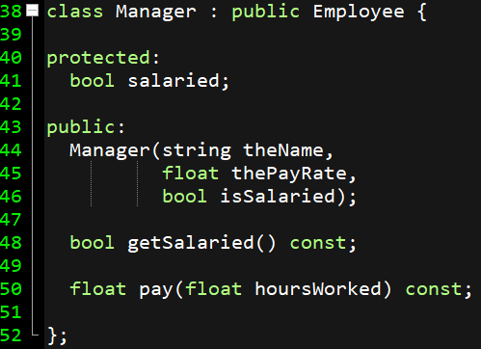
MANAGER CLASS
Figure 5.6 example of polymorphism[2]

Slide 13
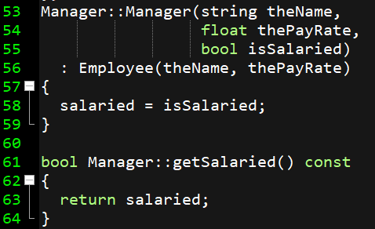
MANAGER CLASS
Figure 5.6 example of polymorphism[2]

Slide 14
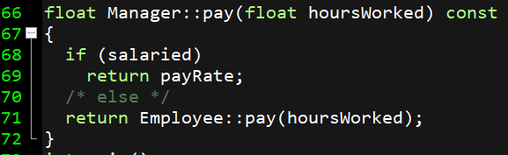
MANAGER CLASS
The pay() method is given a new definition, in which the payRate has 2 possible uses. If the manager is salaried, payRate is the fixed rate for the pay period; otherwise, it represents an hourly rate, just like it does for a regular employee.
Note: Employees paid by a salary (i.e., those that are salaried) get a fixed amount of money each pay period (e.g., week, 2 weeks, month) regardless of how many hours they work.
Figure 5.8 example of polymorphism[2]

Slide 15
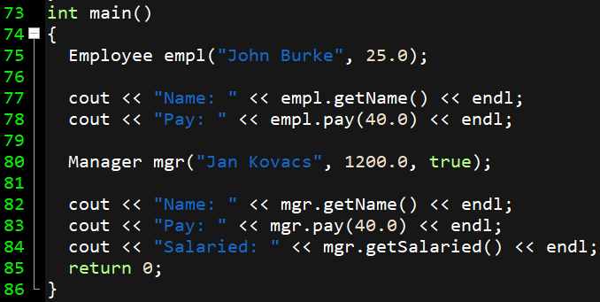
MANAGER CLASS
Figure 5.9 example of polymorphism[2]

Slide 16
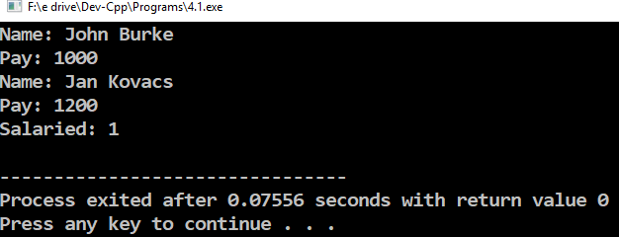
OUTPUT
Figure 5.10 example of polymorphism[2]

Slide 17
EMPLOYEE EXAMPLE-WHY PUBLIC INHERITANCE?
Often, we want a derived class that is a "kind of" the base class:
Employee <-- generic employee
|
Manager <-- specific kind of employee,
but still an "employee"
In these cases, public inheritance:
class Manager : public Employee {
is the kind of inheritance that should be used.
I.e, if a Manager is truly a "kind of" Employee, then it should have all the things (i.e., the same interface) that an Employee has.
Deriving a class publicly guarantees this, as all the public data and methods from the base class remain public in the derived class.

Slide 18
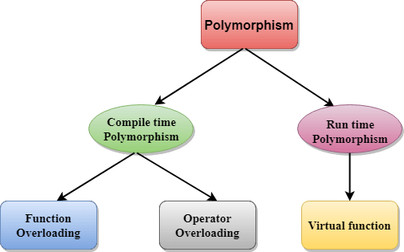
TYPES OF POLYMORPHISM
Figure 5.11 Types of polymorphism[2]

Slide 19
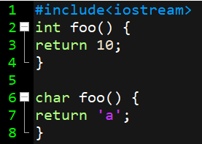

COMPILE TIME POLYMORPHISM
This type of polymorphism is achieved by function overloading or operator overloading.
Function Overloading: When there are multiple functions with same name but different parameters then these functions are said to be overloaded. Functions can be overloaded by change in number of arguments or/and change in type of arguments.
RULES FOR FUNCTION OVERLOADING-
Function declarations that differ only in the return type. For example, the following program fails in compilation.

Slide 20
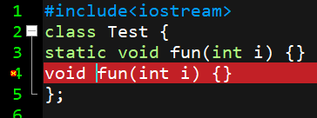

COMPILE TIME POLYMORPHISM
RULES FOR FUNCTION OVERLOADING-
Member function declarations with the same name and the name parameter-type-list cannot be overloaded if any of them is a static member function declaration. For example, following program fails in compilation.
Parameter declarations that differ only in a pointer * versus an array [] are equivalent. That is, the array declaration is adjusted to become a pointer declaration
int fun(int *ptr);
int fun(int ptr[]); // redeclaration of fun(int *ptr)
Figure 5.13 Program made on Dev-C++

Slide 21
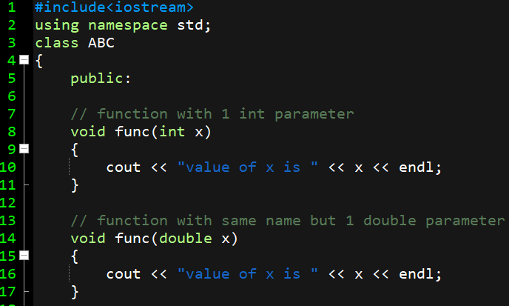
FUNCTION OVERLOADING
EXAMPLE
Figure 5.14 Program made on Dev C++
Notes:
#include<iostream>
using namespace std;
class ABC
{
public:
// function with 1 int parameter
void func(int x)
{
cout << "value of x is " << x << endl;
}
// function with same name but 1 double parameter
void func(double x)
{
cout << "value of x is " << x << endl;
}
// function with same name and 2 int parameters
void func(int x, int y)
{
cout << "value of x and y is " << x << ", " << y << endl;
}
};
int main() {
ABC obj1;
/* Which function is called will depend on
the parameters passed .
The first 'func' is called */
obj1.func(7);
// The second 'func' is called
obj1.func(9.132);
// The third 'func' is called
obj1.func(85,64);
return 0;
}

Slide 22
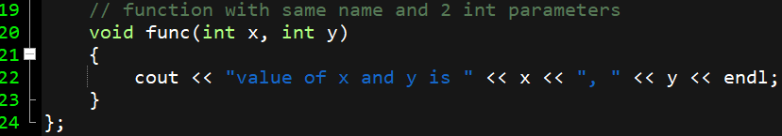
FUNCTION OVERLOADING
EXAMPLE
Figure 5.15 Program made on Dev C++
Notes:
#include<iostream>
using namespace std;
class ABC
{
public:
// function with 1 int parameter
void func(int x)
{
cout << "value of x is " << x << endl;
}
// function with same name but 1 double parameter
void func(double x)
{
cout << "value of x is " << x << endl;
}
// function with same name and 2 int parameters
void func(int x, int y)
{
cout << "value of x and y is " << x << ", " << y << endl;
}
};
int main() {
ABC obj1;
/* Which function is called will depend on
the parameters passed .
The first 'func' is called */
obj1.func(7);
// The second 'func' is called
obj1.func(9.132);
// The third 'func' is called
obj1.func(85,64);
return 0;
}

Slide 23
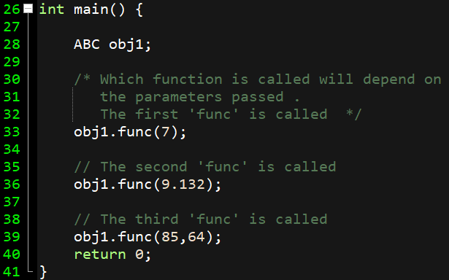
FUNCTION OVERLOADING
EXAMPLE
Figure 5.16 Program made on Dev C++
Notes:
#include<iostream>
using namespace std;
class ABC
{
public:
// function with 1 int parameter
void func(int x)
{
cout << "value of x is " << x << endl;
}
// function with same name but 1 double parameter
void func(double x)
{
cout << "value of x is " << x << endl;
}
// function with same name and 2 int parameters
void func(int x, int y)
{
cout << "value of x and y is " << x << ", " << y << endl;
}
};
int main() {
ABC obj1;
/* Which function is called will depend on
the parameters passed .
The first 'func' is called */
obj1.func(7);
// The second 'func' is called
obj1.func(9.132);
// The third 'func' is called
obj1.func(85,64);
return 0;
}

Slide 24
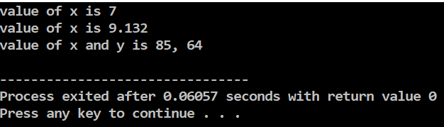
FUNCTION OVERLOADING
EXAMPLE
Figure 5.17 Program made on Dev C++
Notes:
#include<iostream>
using namespace std;
class ABC
{
public:
// function with 1 int parameter
void func(int x)
{
cout << "value of x is " << x << endl;
}
// function with same name but 1 double parameter
void func(double x)
{
cout << "value of x is " << x << endl;
}
// function with same name and 2 int parameters
void func(int x, int y)
{
cout << "value of x and y is " << x << ", " << y << endl;
}
};
int main() {
ABC obj1;
/* Which function is called will depend on
the parameters passed .
The first 'func' is called */
obj1.func(7);
// The second 'func' is called
obj1.func(9.132);
// The third 'func' is called
obj1.func(85,64);
return 0;
}

Slide 25
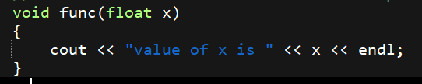
LET’S MODIFY THE PROGRAM
EXAMPLE
Figure 5.18 Program made on Dev C++
Notes:
#include<iostream>
using namespace std;
class ABC
{
public:
// function with 1 int parameter
void func(int x)
{
cout << "value of x is " << x << endl;
}
// function with same name but 1 double parameter
void func(double x)
{
cout << "value of x is " << x << endl;
}
// function with same name and 2 int parameters
void func(int x, int y)
{
cout << "value of x and y is " << x << ", " << y << endl;
}
};
int main() {
ABC obj1;
/* Which function is called will depend on
the parameters passed .
The first 'func' is called */
obj1.func(7);
// The second 'func' is called
obj1.func(9.132);
// The third 'func' is called
obj1.func(85,64);
return 0;
}

Slide 26
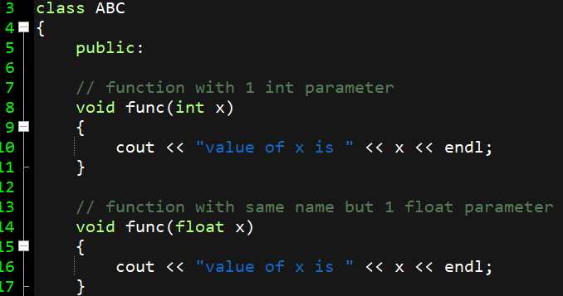
LET’S MODIFY THE PROGRAM and EXECUTE
EXAMPLE
Figure 5.19 Program made on Dev C++
Notes:
#include<iostream>
using namespace std;
class ABC
{
public:
// function with 1 int parameter
void func(int x)
{
cout << "value of x is " << x << endl;
}
// function with same name but 1 double parameter
void func(double x)
{
cout << "value of x is " << x << endl;
}
// function with same name and 2 int parameters
void func(int x, int y)
{
cout << "value of x and y is " << x << ", " << y << endl;
}
};
int main() {
ABC obj1;
/* Which function is called will depend on
the parameters passed .
The first 'func' is called */
obj1.func(7);
// The second 'func' is called
obj1.func(9.132);
// The third 'func' is called
obj1.func(85,64);
return 0;
}

Slide 27
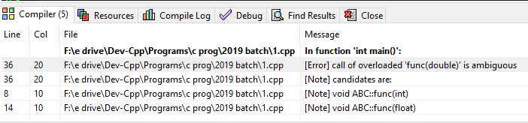
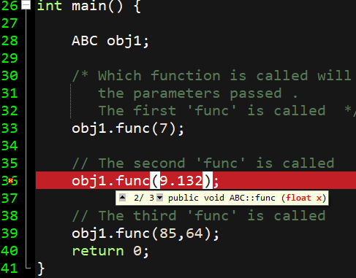
LET’S MODIFY THE PROGRAM and EXECUTE
EXAMPLE
ERROR
Because compiler treats fractional values as double values by default.
Figure 5.20 Program made on Dev C++
Notes:
#include<iostream>
using namespace std;
class ABC
{
public:
// function with 1 int parameter
void func(int x)
{
cout << "value of x is " << x << endl;
}
// function with same name but 1 double parameter
void func(double x)
{
cout << "value of x is " << x << endl;
}
// function with same name and 2 int parameters
void func(int x, int y)
{
cout << "value of x and y is " << x << ", " << y << endl;
}
};
int main() {
ABC obj1;
/* Which function is called will depend on
the parameters passed .
The first 'func' is called */
obj1.func(7);
// The second 'func' is called
obj1.func(9.132);
// The third 'func' is called
obj1.func(85,64);
return 0;
}

Slide 28
Summary
In this lecture we have discussed about Polymorphism
We have discussed about how to apply polymorphism.
Discussed about types of polymorphism
Discussed about Function overloading.

Slide 29
Frequently Asked question
Q1 What is a polymorphism?
Polymorphism means "many forms", and it occurs when we have many classes that are related to each other by inheritance. Like we specified in the previous chapter; Inheritance lets us inherit attributes and methods from another class. Polymorphism uses those methods to perform different tasks.
Q2 What is an compile time polymorphism?
This type of polymorphism is achieved by function overloading or operator overloading. Function Overloading: When there are multiple functions with same name but different parameters then these functions are said to be overloaded

Slide 30
Q3 What is run time polymorphism and how to achieve it ?
This type of polymorphism is achieved by Function Overriding. Function overriding on the other hand occurs when a derived class has a definition for one of the member functions of the base class. That base function is said to be overridden.
It can achieved by Method overriding in which a child class overrides a method in its parent. An overridden method is essentially hidden in the parent class, and is not invoked unless the child class uses the super keyword within the overriding method.

Slide 31
Assessment Questions:
1. Which of the following statement is not correct about function overiding?
A. Function overriding cannot be done within a class.
B. Overridden function must have same return type and same parameter list.
C. A function can be overridden only once.
D. Static function cannot be overridden.
2. Which among the following best describes polymorphism? a) It is the ability for a message/data to be processed in more than one form b) It is the ability for a message/data to be processed in only 1 form c) It is the ability for many messages/data to be processed in one way d) It is the ability for undefined message/data to be processed in at least one way.

Slide 32
Discussion forum.
What is the real life example of polymorphism? Try to implement it in form of C++ program.
https://www.youtube.com/watch?v=ZcWUk9C4suI

Slide 33

REFERENCES
Reference Books
[1] Programming in C++ by Reema Thareja.
[2] Programming in ANSI C++ by E. Balaguruswamy, Tata McGraw Hill.
[3] Programming with C++ (Schaum's Outline Series) by Byron Gottfried Jitender Chhabra, Tata McGraw Hill.
Websites:
https://www.w3schools.com/cpp/cpp_polymorphism.asp
https://www.tutorialspoint.com/cplusplus/cpp_polymorphism.htm
YouTube Links:
https://www.youtube.com/watch?v=oHT0GiE8MkM

Slide 34
THANK YOU

